Slide 1
Data Structures

Slide 2
Agenda
Count subarrays with given sum
Largest subarray with 0 sum
Internal Working of HashMap
Internal Working of HashSet

Slide 3
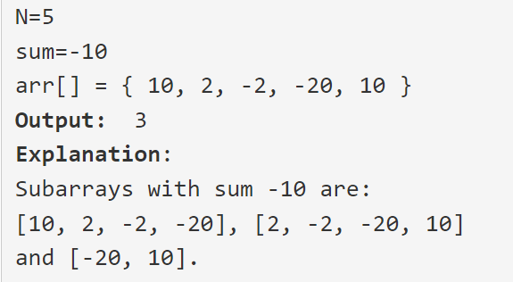
Count subarrays with given sum
Link: https://practice.geeksforgeeks.org/problems/subarray-range-with-given-sum2804/1/

Slide 4
Count subarrays with given sum
Link: https://practice.geeksforgeeks.org/problems/subarray-range-with-given-sum2804/1/

Slide 5
Count subarrays with given sum
Link: https://practice.geeksforgeeks.org/problems/subarray-range-with-given-sum2804/1/

Slide 6

Largest subarray with 0 sum
Link: https://practice.geeksforgeeks.org/problems/largest-subarray-with-0-sum/1/

Slide 7
Internal Working of HashMap
Hash of the key

Slide 8
Internal Working of HashMap

Slide 9
Internal Working of HashMap

Slide 10
Internal Working of HashMap

Slide 11
Internal Working of HashSet

Slide 12
THANK YOU

